Slide 1
Maxwell’s Equations

Slide 2
Contents
Motivation
Basic Calculus
Introduction to Electro Magnetics
Maxwell’s Equations
Displacement Current
Final Form of Maxwell’s Equations
Applications of Maxwell’s Equations

Slide 3
Motivation

Slide 4
“And GOD said, let there be light : and there was light” Genesis 1:3
And then God said, let
And there was Light ….
(Anonymous)

Slide 5
Basic Calculus
We will be using following Identities for a better understanding of Maxwell’s Equations.
Ordinary Derivative: For one variable functions ordinary derivative is used and represents slope of function.
Gradient : For multivariable functions we use ‘Del’ operator given by

Slide 6
Basic Calculus
Divergence( ) : Dot product of ∆ with a vector quantity is called as divergence and gives us a scalar result. Physically this gives a measure of how much does spreads out from point of observation .
Curl( ): Cross product of del with a vector quantity is called as curl . Physically this tells us about how much the vector quantity turns around point of consideration.

Slide 7
Basic Calculus
Gradient is normal to surfaces ϕ=constant

Slide 8
Basic Identities
Curl of Gradient is always zero
Divergence of Curl is always Zero

Slide 9
Basic Theorems For
Gauss’s Divergence theorem
Divergence :
Curl :
Stoke’s Theorem

Slide 10
Introduction to Electromagnetic Fields
Maxwell’s
equations
Electro-statics
Magneto-statics
Electro-magnetic waves
Geometric Optics
Statics:
Transmission
Line
Theory
Input from other disciplines
Circuit
Theory
Kirchoff’s Laws

Slide 11
Introduction to Maxwell’s Equations
The study of Maxwell’s equations, devised in 1863 to represent the relationships between electric and magnetic fields in the presence of electric charges and currents, whether steady or rapidly fluctuating, in a vacuum or in matter.
The equations represent one of the most elegant and concise way to describe the fundamentals of electricity and magnetism. They pull together in a consistent way earlier results known from the work of Gauss, Faraday, Ampère, Biot, Savart and others.
Remarkably, Maxwell’s equations are perfectly consistent with the transformations of special relativity.

Slide 12
Maxwell’s Equations
Symmetry tells about a missing term in one of Maxwell's equations.
Updated Maxwell’s equations leads to the prediction of EM waves travelling with speed of light.
Helps in understanding of optics, radio and TV transmissions .
Maxwell’s equation along with Lorentz force explains the classical EM interactions.

Slide 13
Maxwell’s Equations
Relate Electric and Magnetic fields generated by charge and current distributions.
E = electric field
B = magnetic flux density
ρ= charge density
j = current density
μ₀ (permeability of free space) = 4π 10⁻⁷
ε₀ (permittivity of free space) = 8.854 10⁻¹²
Gauss’s Law : relates E with source
Faraday’s Law: relates E and B
Biot Savart law

Slide 14
First Equation
Equivalent to Gauss’ Flux Theorem:
Total Electric flux out of a closed surface is proportional to charge enclosed by that surface.

Slide 15
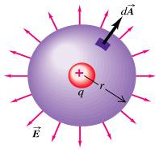
Example of Sphere
Electric field of this charge q is given as

Slide 16
Second Equation
Gauss’ law for magnetism:
The net magnetic flux out of any closed surface is zero.
Gauss’ law for magnetism is then a statement that There are no magnetic monopoles .

Slide 17
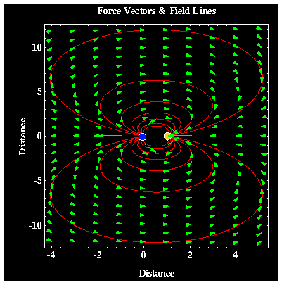
Example
Surface enclosing Magnetic dipole
Surround a magnetic dipole with a closed surface. The magnetic flux directed inward towards the south pole will equal the flux outward from the north pole.

Slide 18
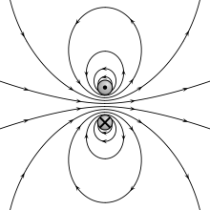
Magnetic dipoles

Slide 19
Third Equation
Using Stoke’s theorem this becomes equivalent to Faraday’s Law of Induction.
N
S
Faraday’s Law relating rate of change in flux with the e.m.f around the circuit is for electric generators , inductors and transformers.

Slide 20
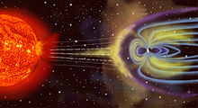
Faraday’s Law
In a geomagnetic storm, a surge in the flux of charged particles temporarily alters Earth's magnetic field, which induces electric fields in Earth's atmosphere, thus causing surges in electrical power grids.

Slide 21
Forth Equation
Originates from Ampère’s (Circuital) Law :
Satisfied by the field for a steady line current (Biot-Savart Law, 1820):

Slide 22
Displacement Current
Faraday’s law states that a changing B-field should produce an E-field
Maxwell wanted to have it other way around too but it was not covered in Biot-Savarat Law.
But there was a problem with one Equation!
But

Slide 23
Displacement Current
Apply Ampère to surface 1 (flat disk): line integral of B = μ₀I
Applied to surface 2, line integral is zero since no current penetrates the deformed surface.
In capacitor, , so
Displacement current density is
Surface 1
Surface 2
Current I
Closed loop

Slide 24
Ampere’s Law
It states that magnetic fields can be generated in two ways: by electrical current (this was the original "Ampere's law") and by changing electric fields (this was "Maxwell's correction").
Maxwell's correction to Ampere's law is particularly important: it shows that not only does a changing magnetic field induce an electric field, but also a changing electric field induces a magnetic field.
Therefore, these equations allow self-sustaining "electromagnetic waves" to travel through empty space .

Slide 25
Final form of Maxwell’s Equations
Differential Form
Integral Form

Slide 26
Consistency with Charge Conservation
Charge conservation:
Total current flowing out of a region equals the rate of decrease of charge within the volume.
From Maxwell’s equations: Take divergence of (modified) Ampère’s equation

Slide 27
Wave Equations
Following 2nd order PDE describes the propagation of EM waves through medium or space.

Slide 28
Wave Equations
The homogeneous form of the equation, written in terms of either the Electric field E or the Magnetic field B, takes the form
This second order derivative w.r.t space and time is called as d’Alembertion and denoted as

Slide 29
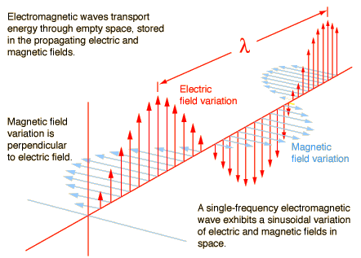
Electromagnetic waves

Slide 30
Application of Maxwell’s Equations
Radiation therapy is the treatment using penetrating x-rays, gamma-rays, or particles such as protons or neutrons on the affected region of the body to destroy the cancer cells. Radiation therapy is a modern treatment technique where the results are faster with fewer side effects than other more traditional forms of treatment.

Slide 31
Application of Maxwell’s Equations
X-Rays
X-rays are a type of radiation used for medical diagnosis. X-rays are not only used in medicine but also in industry, at airports to check customers and baggage, and by art historians to see if a picture has been painted on top of an older one.

Slide 32
Application of Maxwell’s Equations
Gamma Rays
Gamma rays are electromagnetic radiation like X-rays, but they have higher energy. Gamma-rays can kill living cells, a fact which medicine uses to its advantage, using gamma-rays to kill cancerous cells.

Slide 33
Applications of Maxwell’s Equations
Magneto hydrodynamic (MHD)
The interaction of electrically conducting fluids with magnetic fields. The fluids can be ionized gases (commonly called plasmas) or liquid metals. Magneto hydrodynamic (MHD) phenomena occur naturally in the Earth's interior, constituting the dynamo that produces the Earth's magnetic field; in the magnetosphere that surrounds the Earth.

Slide 34
Applications of Maxwell’s Equations
Electric Guitar
Basic principle of Magnetic Induction is employed in order to produce sound in guitars.
Electro magnetic pick-ups are used to sense vibrations in the string electrically , produced by finger or metal strip, and route this electrical signal to amplifier or speaker .

Slide 35
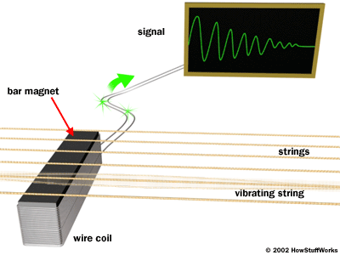
Applications of Maxwell’s Equations
The vibrations of the string causes a changing B-field that thus producing an electrical signal carried out to the amplifier.

Slide 36
Sample problem
Given an Electric field
Find displacement current density.
Displacement current .

